Slide 1
Software Analysis and Design (CS:324)
State Diagram

Slide 2
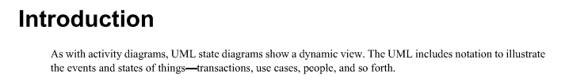
State diagram/State chart / State Machine Diagram:

Slide 3
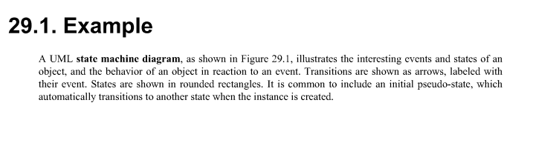
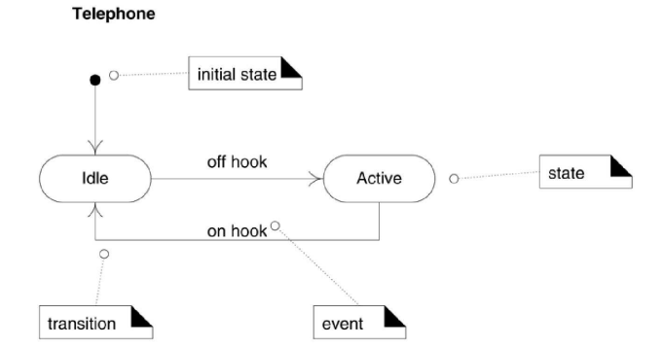

Slide 4
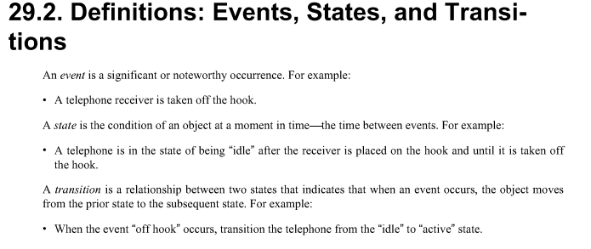

Slide 5
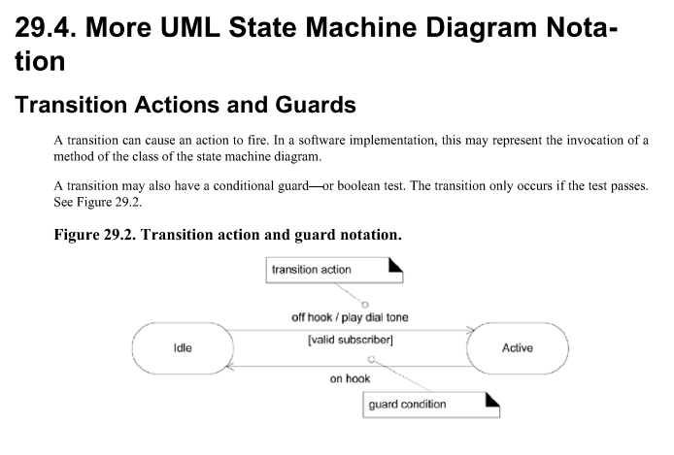

Slide 6
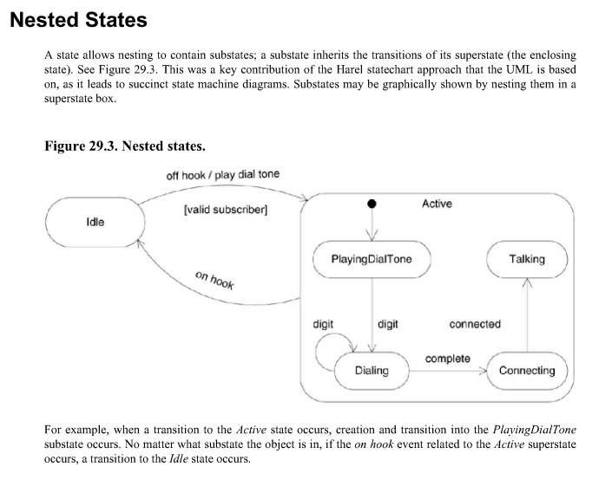

Slide 7
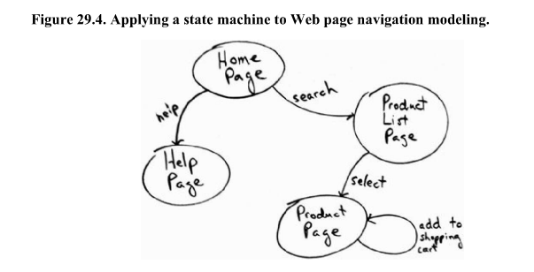

Slide 8
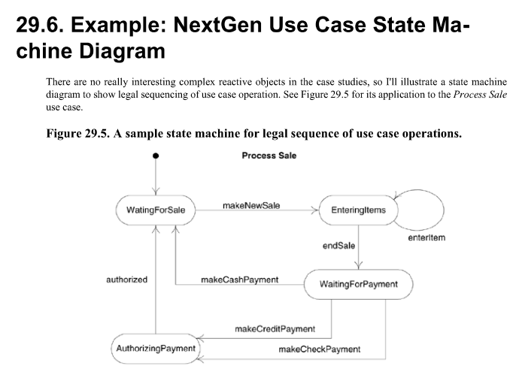

Slide 9
Scenario:
A car Rental company wants to develop an automated system that would handle car reservations, customer billing and car auctions. Usually a customer reserves any available car, picks it up and then returns it after a certain period of time. When the car is returned, the customer receives a bill and pays the specified amount. In addition to renting out cars, every year, the company auctions the cars which have accumulated over 30,000 kilometers. For a particular car, there can be many reservations for different time periods and the company may make reservations for a car for future time periods even while it is picked. There can be situations where a car may not have any reservations at all and hence, the car would be truly available for reservations or auctioning.
Draw a state diagram showing all the states and transitions of a car object to include the events which cause the
transitions.

Slide 10
